Slide 1
SMART MIRROR
Group 6

Slide 2
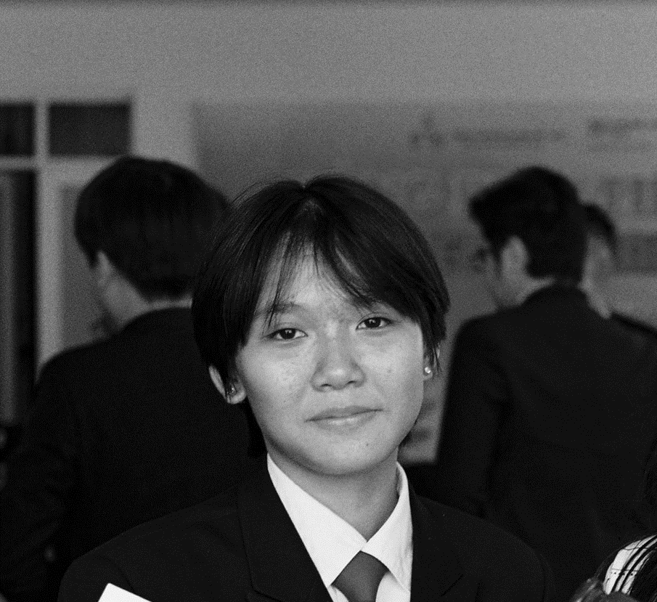
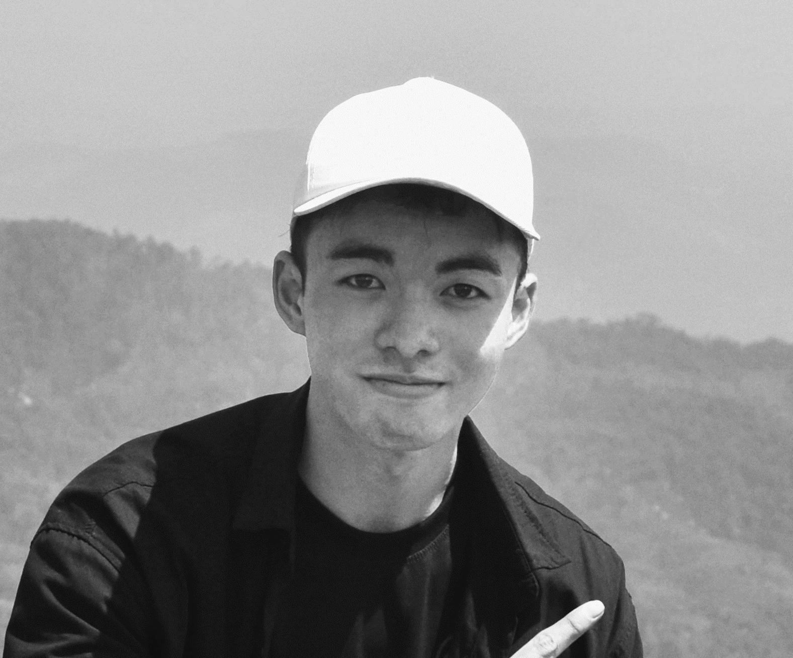
Our team
LE NGUYEN PHUONG
LE NGUYEN HUU QuOC

Slide 3
01
INTRODUCTION
02
DESIGN AND IMPLEMENT
Table of contents
03
CONCLUSION
04
DEMONSTRATION

Slide 4

01
INTRODUCTION

Slide 5
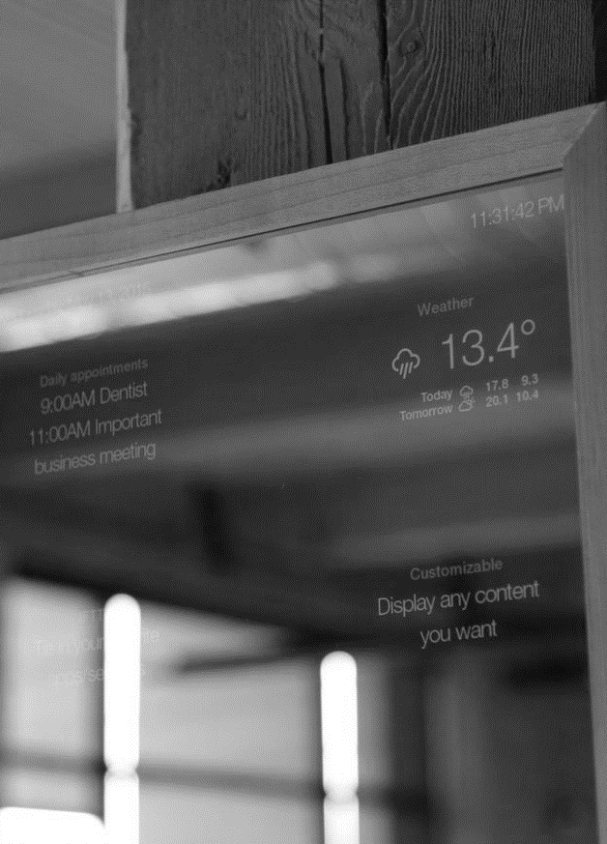
introduction
A smart mirror is a two-way mirror with an electronic display attached behind the glass;
It can show time, date, weather, and news updates.
It would be useful for busy individuals who want to multitask and stay informed while on the go.

Slide 6
Problem
Using smartphone: time-consuming and distracting;
Using Google Assistant Glass Mirror: expensive.

Slide 7
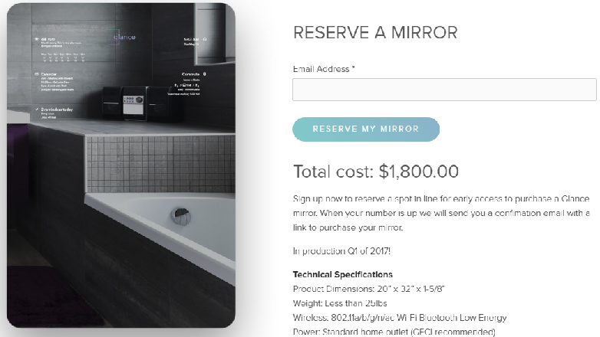
MARKET COMPARISONS

Slide 8
Solution
Get informed while finishing daily tasks without constantly pulling out a device;
Cheap and easy to produce.

Slide 9
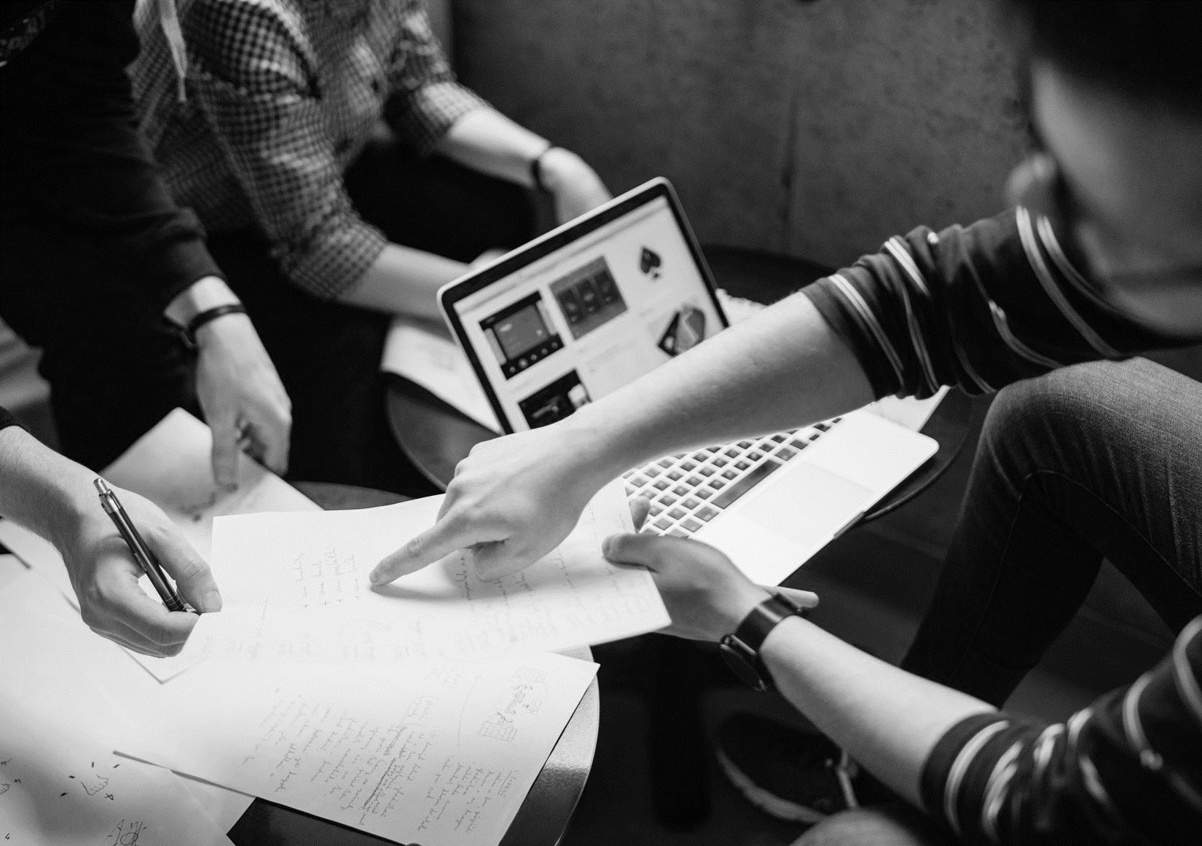
02
DESIGN AND IMPLEMENT

Slide 10
HARDWARE
Mirror: is used to reflect images;
Frame: is used to protect the glass and contain the circuitry;
Circuitry: is used to contain the code, transmit electric current and control signals.

Slide 11
HARDWARE
Mirror: a transparent glass, with one-way reflective decal sticked on the glass surface. The rest of the glass around the display is blacked out by use of cardboard to ensure that there was a good reflection. Two-way mirror is more recommended because it lets the graphics on the display come through clearer.

Slide 12
HARDWARE
Frame: a solid cardboard box. If possible, use a wooden frame to make it sturdier and more solid. You can also decorate it to make it more eye-catching and beautiful.

Slide 13
HARDWARE
Circuitry:
Arduino UNO;
Solid core jumper wires;
10KΩ potentiometer;
Resistors;
(16×2 character display);
Temperature sensor TMP36;
LCD
USB cable;
Power supply;
Switch.

Slide 14
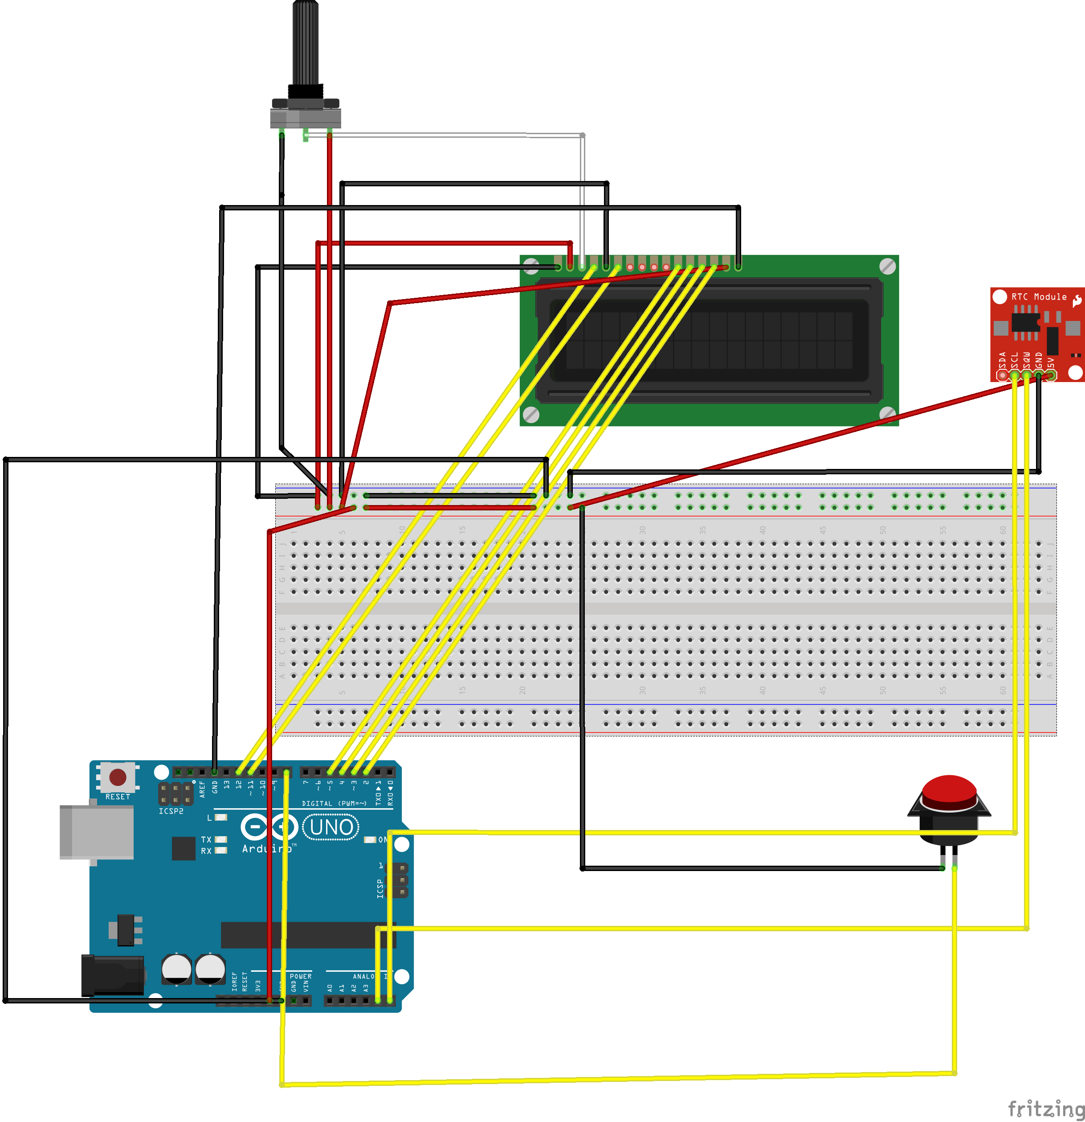

Slide 15
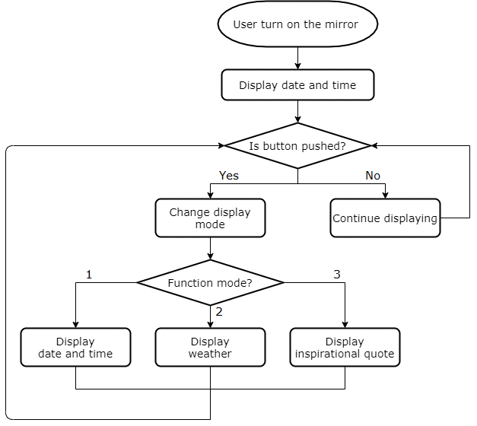
SOFTWARE

Slide 16
SOFTWARE
#include <LiquidCrystal.h> //implement LiquidCrystal and setCursor()
#include <DS1307RTC.h> //provide RTC control functions
#include <TimeLib.h> //implement functions getting real time
LiquidCrystal lcd(12, 11, 5, 4, 3, 2);
const int switchPin = 8;
int hits = 0;
int switchState = 0;
int prevSwitchState = 0;
int tempPin = 1;
int temValue;
float tempCelsius;
int countQuotes = 0;
String quotes[14];

Slide 17
SOFTWARE
void setup()
{
lcd.clear();
lcd.begin(16, 2);
pinMode(switchPin, INPUT);
}
void loop()
{
switchState = digitalRead(switchPin);
if (switchState != prevSwitchState)
{
if (switchState == LOW)
{
hits++;
switch (hits % 3)
{
case 0:
timeDisplay();
delay(300);
break;
case 1:
weatherDisplay();
delay(300);
break;
case 2:
quotesDisplay();
delay(300);
break;
}
}
}

Slide 18
SOFTWARE
void print2digits(int number)
{
if (number >= 0 && number < 10)
{
lcd.write('0');
}
lcd.print(number);
}
void timeDisplay()
{
tmElements_t tm;
lcd.clear();
if (RTC.read(tm))
{
lcd.setCursor(4, 0);
print2digits(tm.Hour);
lcd.write(':');
print2digits(tm.Minute);
lcd.write(':');
print2digits(tm.Second);
lcd.setCursor(3, 1);
print2digits(tm.Day);
lcd.write('/');
print2digits(tm.Month);
lcd.write('/');
lcd.print(tmYearToCalendar(tm.Year));
}
}

Slide 19
SOFTWARE
void weatherDisplay()
{
temValue = analogRead(tempPin);
tempCelsius = temValue * 500 / 1023;
lcd.clear();
lcd.setCursor(2, 0);
lcd.print("Temperature: ");
lcd.setCursor(6, 1);
lcd.print(round(tempCelsius));
lcd.write(0xDF);
lcd.print("C");
}
void quotesDisplay()
{
lcd.clear();
lcd.setCursor(0, 0);
String text1 = quotes[countQuotes++];
lcd.print(text1);
lcd.setCursor(0, 1);
String text2 = quotes[countQuotes++];
lcd.print(text2);
if (countQuotes >= 14)
{
countQuotes %= 14;
}
}

Slide 20

03
CONCLUSION AND DEVELOPEMENTS

Slide 21
ADVANTAGES
DISADVANTAGES
Cheap and easy to implement;
No need to use additional third-party software;
No need to use other devices like phone, tablet, laptop.
The data is taken from the sensor so the accuracy is not high;
Not using two-way glass so the graphics on the display is not sharp.

Slide 22
DEVELOPMENT DIRECTIONS
Increase size and make a stronger frame;
Add motion sensor to detect people coming;
Add feature connecting wifi to get data from Google;
Add more kinds of information.

Slide 23

04
DEMONSTRATION

Slide 24
DEMO

Slide 25
THANKS
Do you have any question?
smartmirror@gmail.com
+84 337 746 758
smartmirror.com

